Slide 1
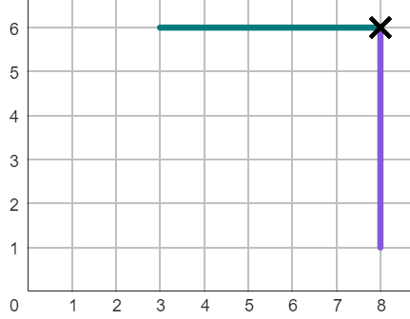

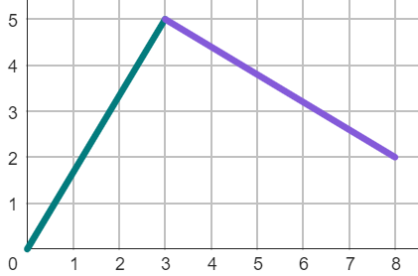
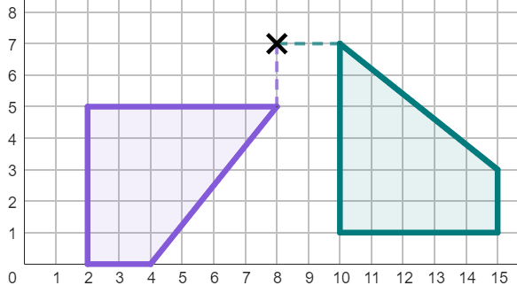
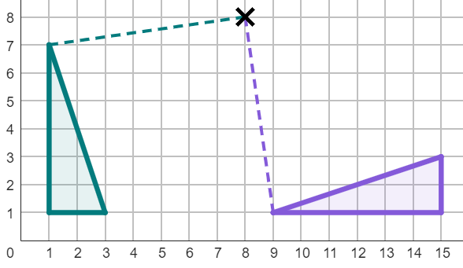
Understanding the centre of rotation
Task A: Describing with the centre of rotation
1) The line has been rotated less than 360°.
Complete the information for the rotation of this line:
The object has been rotated:
anti-clockwise by °
with a centre of rotation at .
90
(8, 6)
2) The line has been rotated less than 360°.
Complete the information for the rotation of this line:
The object has been rotated:
clockwise by °
with a centre of rotation at .
270
(3, 5)
3) The object has been rotated less than 360°.
Complete the information for the rotation:
The object has been rotated:
clockwise by °
with a centre of rotation at .
90
(8, 7)
4) The object has been rotated less than 360°.
Complete the information for the rotation:
The object has been rotated:
anti-clockwise by °
with a centre of rotation at .
90
(8, 8)

Slide 2
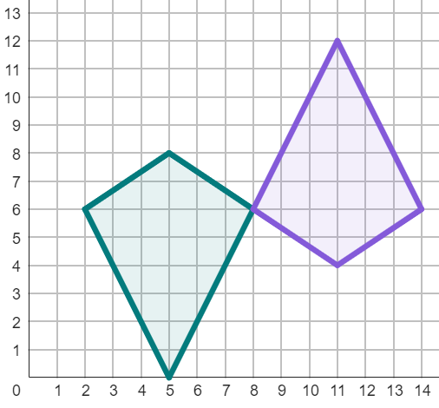
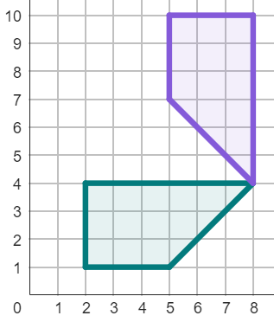
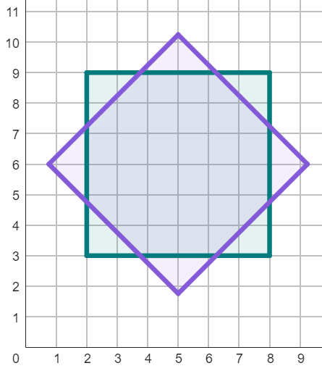
Understanding the centre of rotation
5) There are lots of ways to fully describe this rotation. Complete these two descriptions:
The object has been rotated:
clockwise by °
with a centre of rotation at .
The object has been rotated:
anti-clockwise by °
with a centre of rotation at .
180
(8, 6)
Or (180 + 360n)°
180
(8, 6)
Or (180 + 360n)°
6) There are two ways of describing this rotation, if done in less than a full turn. Complete both descriptions:
The object has been rotated:
clockwise by °
with a centre of rotation at .
The object has been rotated:
image
90
(8, 4)
anti-clockwise
270°
object
with a centre of rotation at (8, 4)
7) There are multiple possible descriptions that could correctly describe this rotation. Fully describe this rotation in one way.
The object has been rotated:
by °
with a centre of rotation at .
image
anti-clockwise
45
(5, 6)
Can either be clockwise or anti-clockwise
Angle must be 45° greater than a multiple of 90°, such as 135° or 215°.
Centre of Rotation must be (5, 6).
object

Slide 3
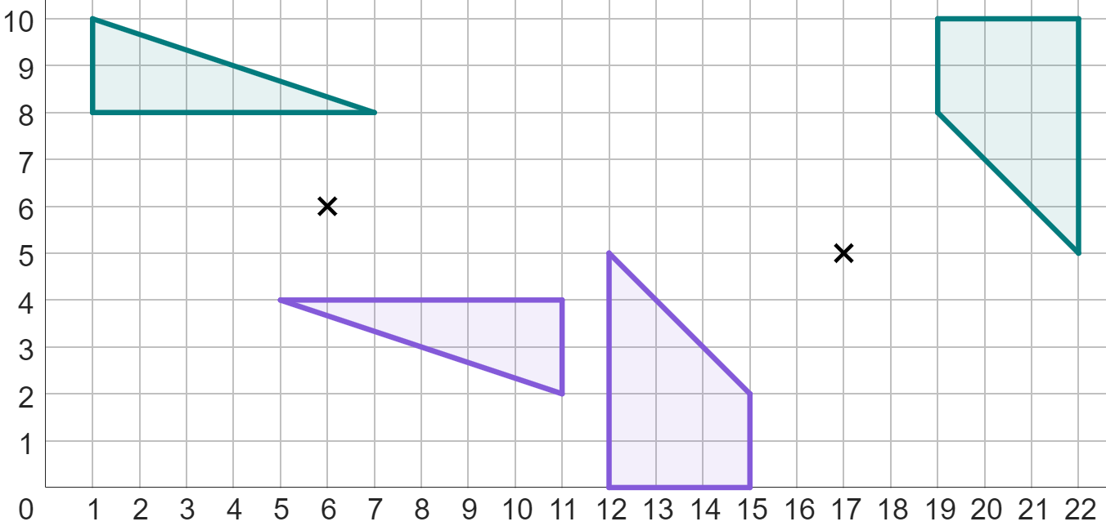
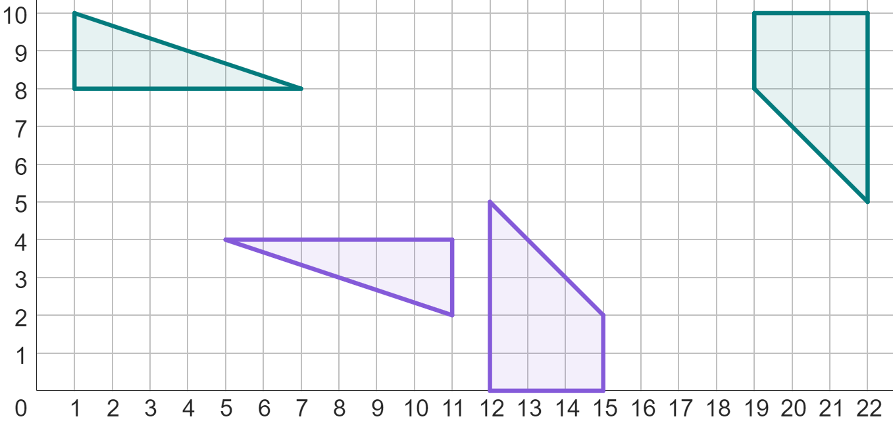
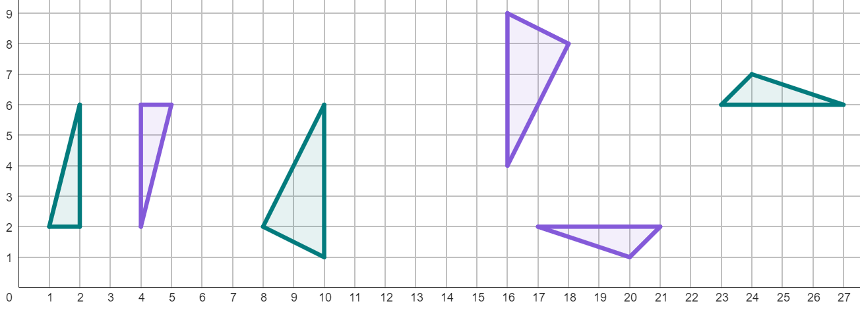
Understanding the centre of rotation
Task B: Finding the centre of rotation for 180° rotations
1) Below are two rotations where an object and its image have two pairs of corresponding vertices labelled. By connecting these corresponding vertices with line segments, find the centre of rotation of each object.
B
B
C
A
C
A
(6, 6)
D′
D′
D
A′
D
A′
(17, 5)
B′
B′
C′
C′
2) By connecting corresponding points on the object and image, find the centre of rotation for these rotations.
(3, 4)
(13, 5)
(22, 4)
3) Complete the sentence below:
“To find the centre of rotation by connecting corresponding points, the image must have been rotated by °.”
180

Slide 4
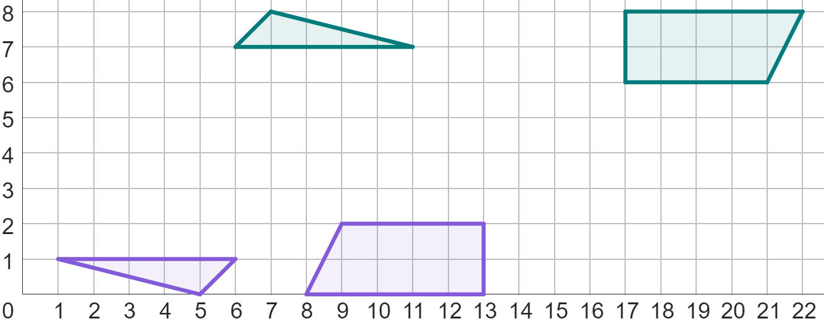
Understanding the centre of rotation
4) Fully describe these rotations.
object 1
object 2
Description for object 1
Description for object 2
Object 1 has been rotated 180° around the centre of rotation of (6, 4).
Object 2 has been rotated 180° around the centre of rotation of (15, 4).
Mathematics in Education and Industry
v2.2

